Slide 1
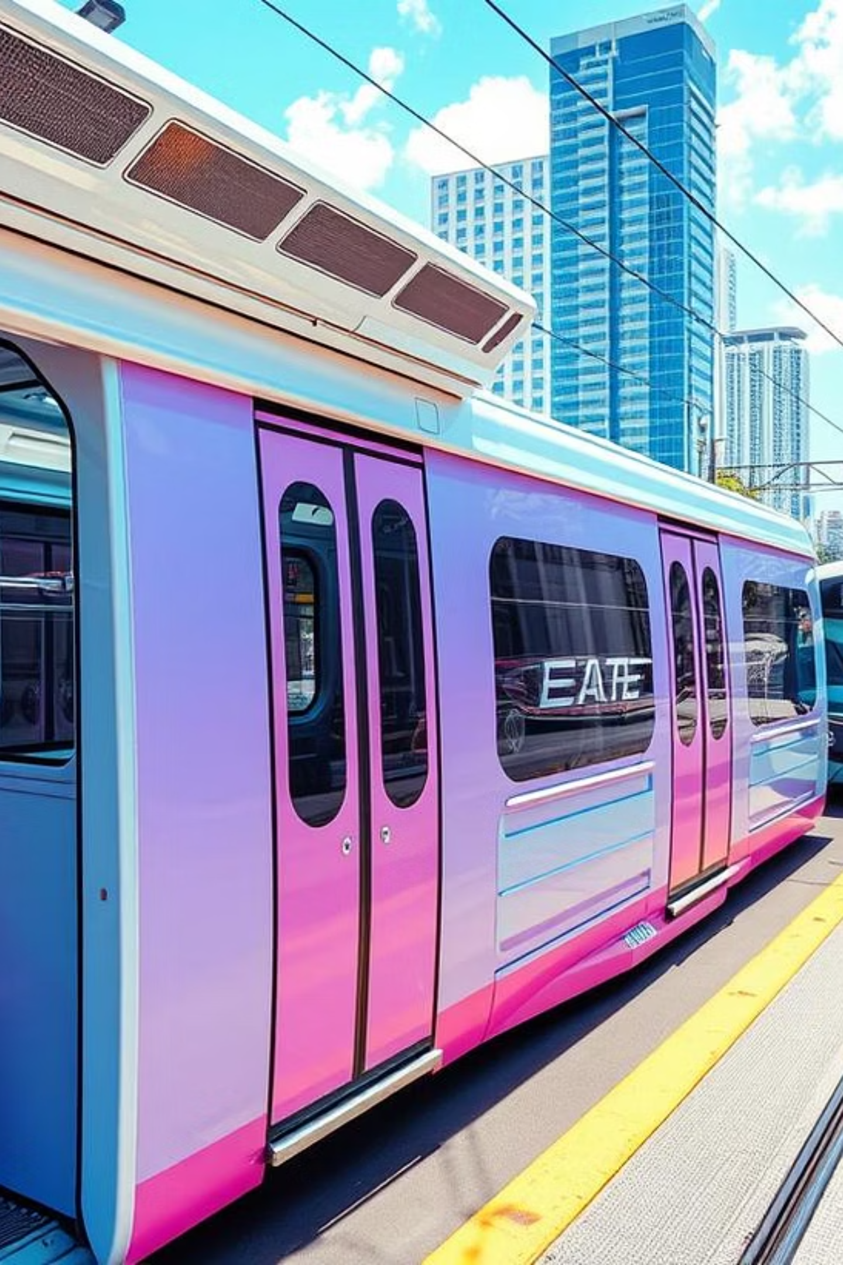
MetroMove Transit Analysis Project

Slide 2

MetroMove Transit Analysis Project
Exploring Patterns, Passenger Behavior, and Operational Efficiency
Presented by: Olatunji Ahmed (Jnr Data Scientist)
Date: JULY 2020

Slide 3

Project Objective
Clean and analyze MetroMove's trip data
Identify inefficiencies and passenger usage trends
Visualize data for operational insights
Provide actionable recommendations

Slide 4
What Was Done
Cleaned inconsistent entries (e.g., transport modes like "bus", "Bus", "BUS")
Descriptive statistics on passenger count, fare, trip duration
Visualizations:
Most used transport modes
Average fare by transport type
Trips by day of week
Total passengers per mode
Bivariate analysis: fare vs. duration, fare vs. passenger count
Outlier identification using boxplots

Slide 5
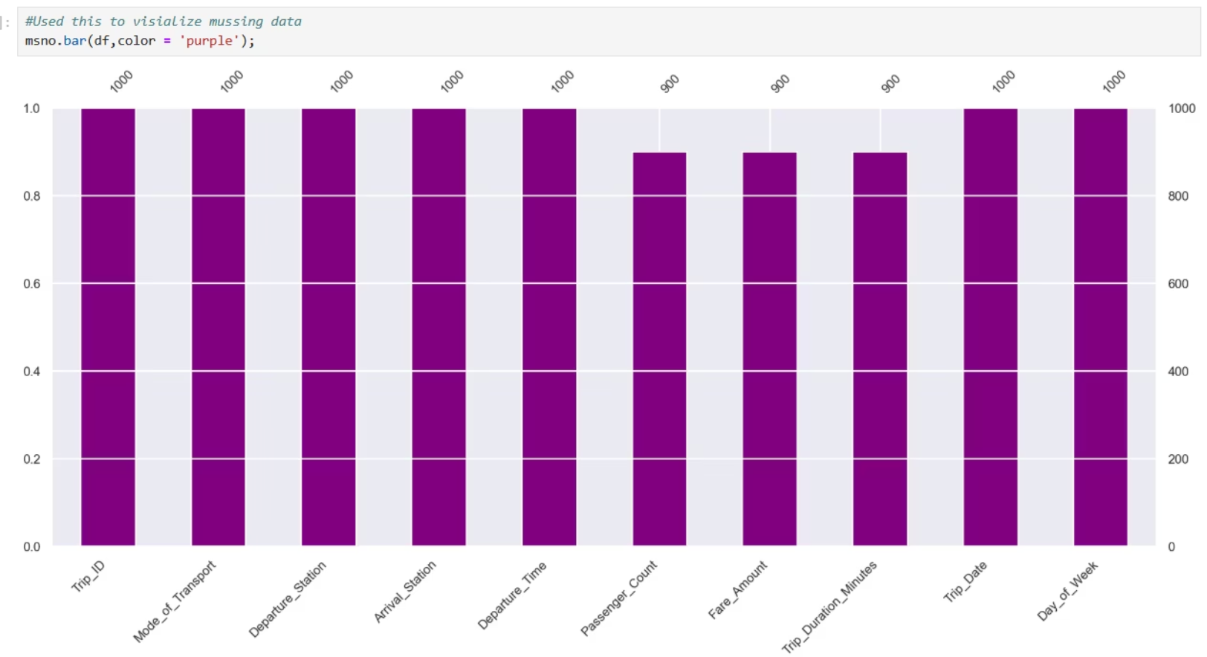
Investigated and visualized missing data. Discovered we have 10% missing data in passenger count, fare_amount etc

Slide 6
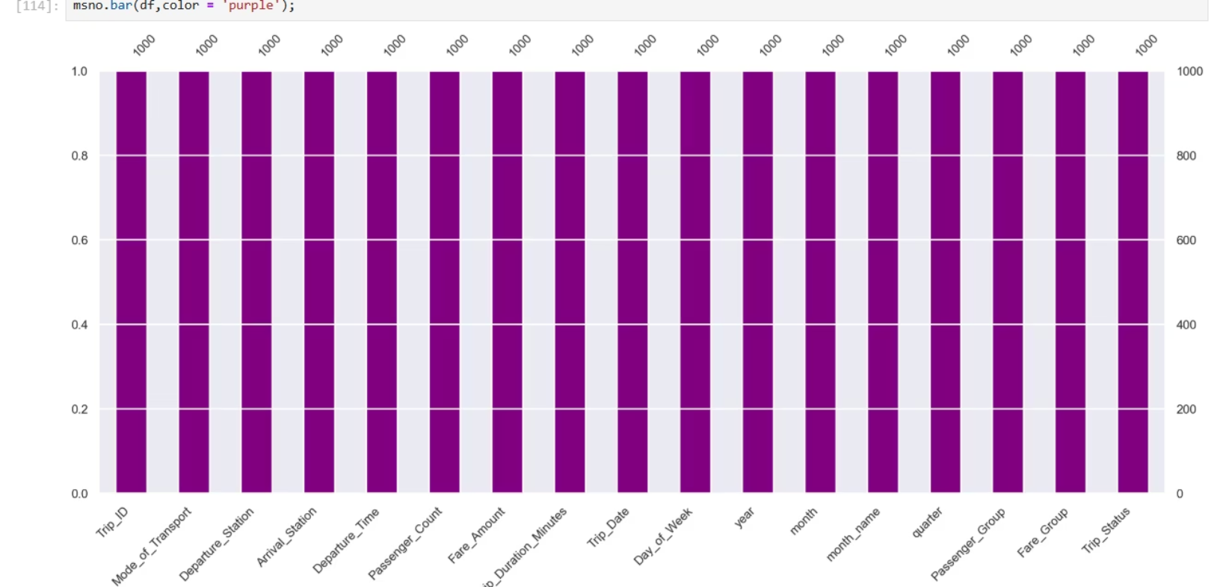
FIXED THE MISSING DATA,by filling it up

Slide 7
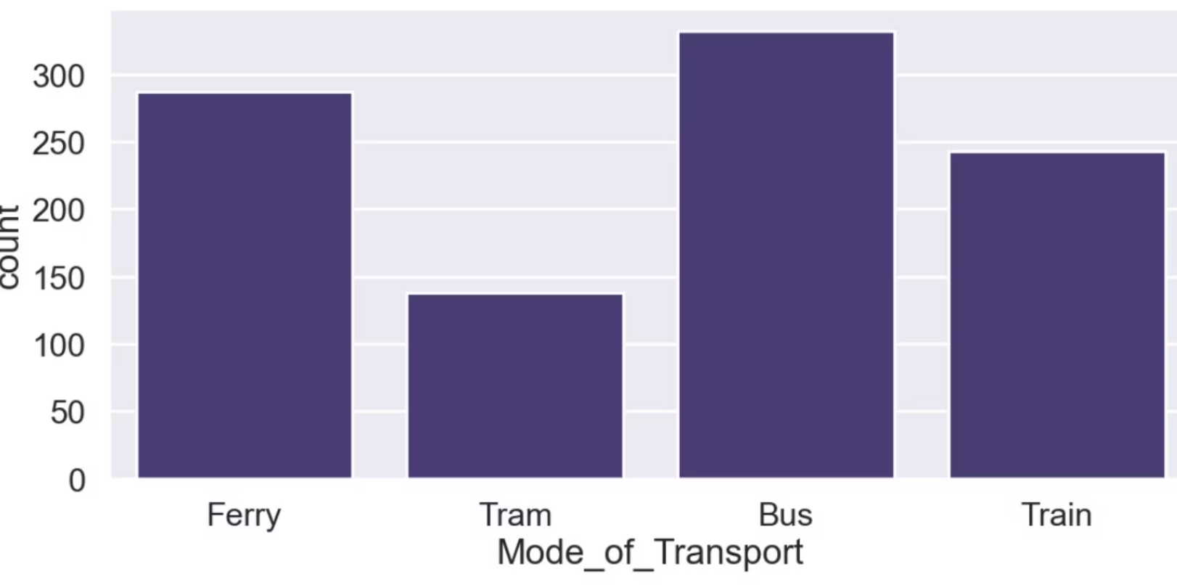
Key Insights
UNIVARIATE ANALYSIS
As seen in the chat, Bus
Bus has the highest usage and passenger volume, followed by ferry. Meaning alot of people prefer to use the bus

Slide 8
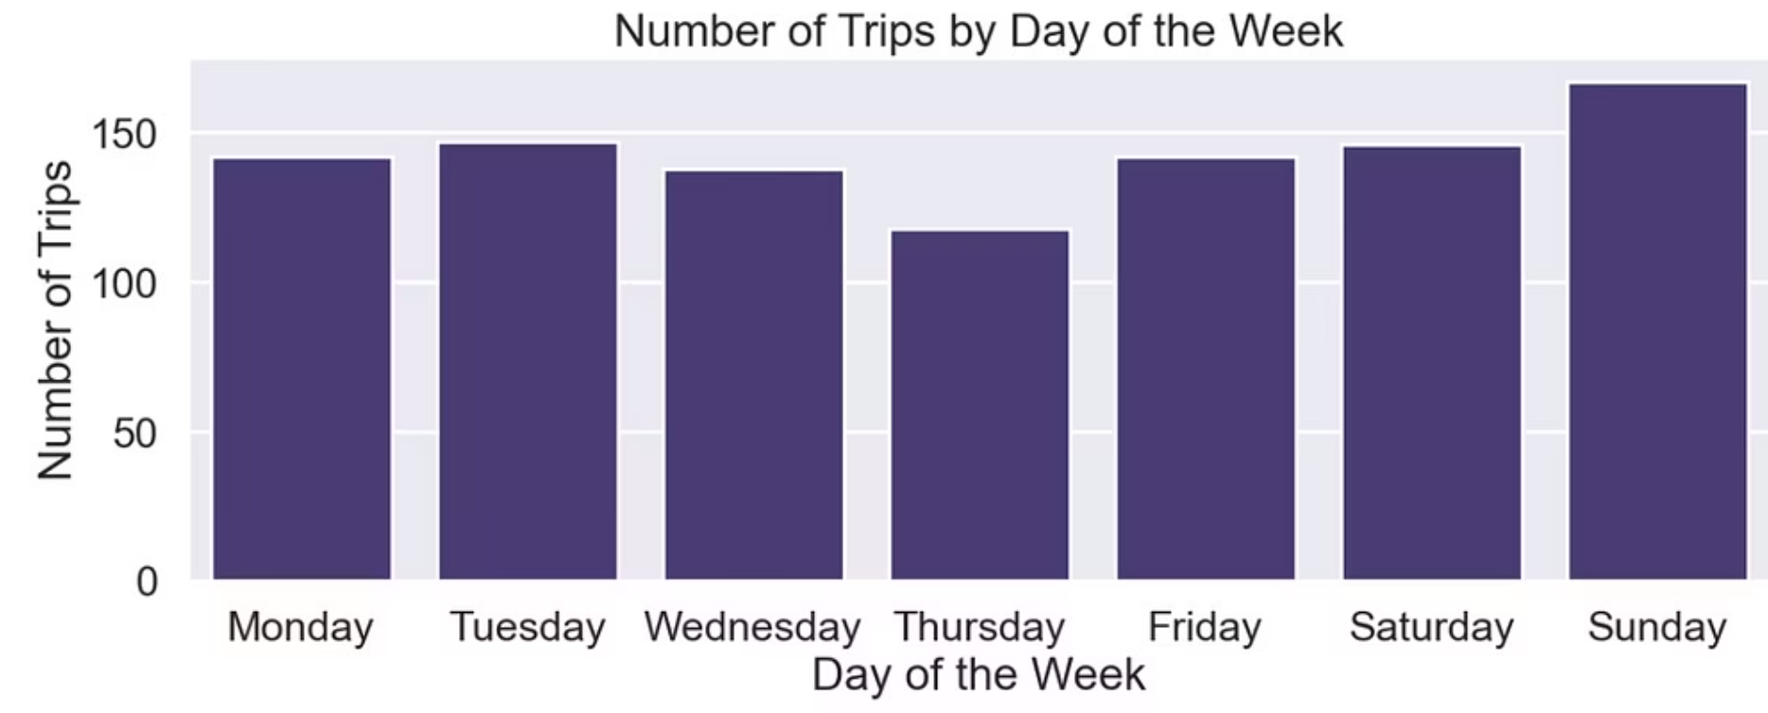
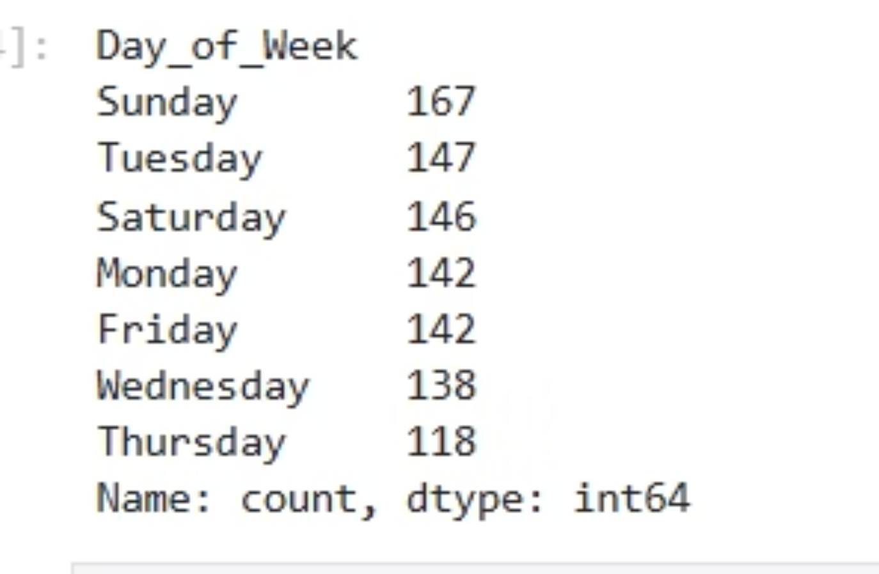
Key Insights/univariate analysis
Sunday sees the highest trip count . it seems a lot of people travel on weekends
The total amount of trips on sunday is 167

Slide 9
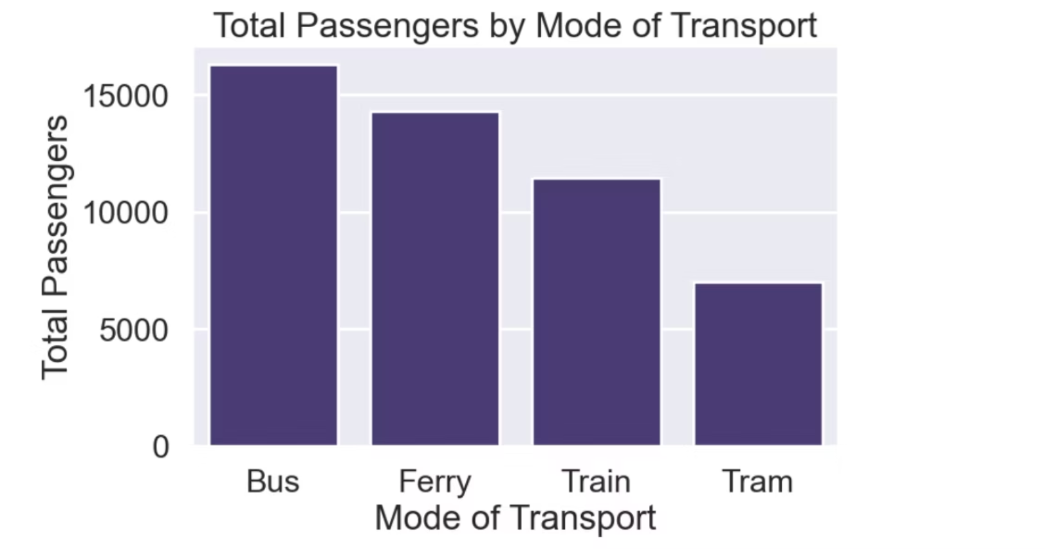
How Many Passengers Use Each Transport Mode
This shows that so many passengers use buses as a mode of transport

Slide 10
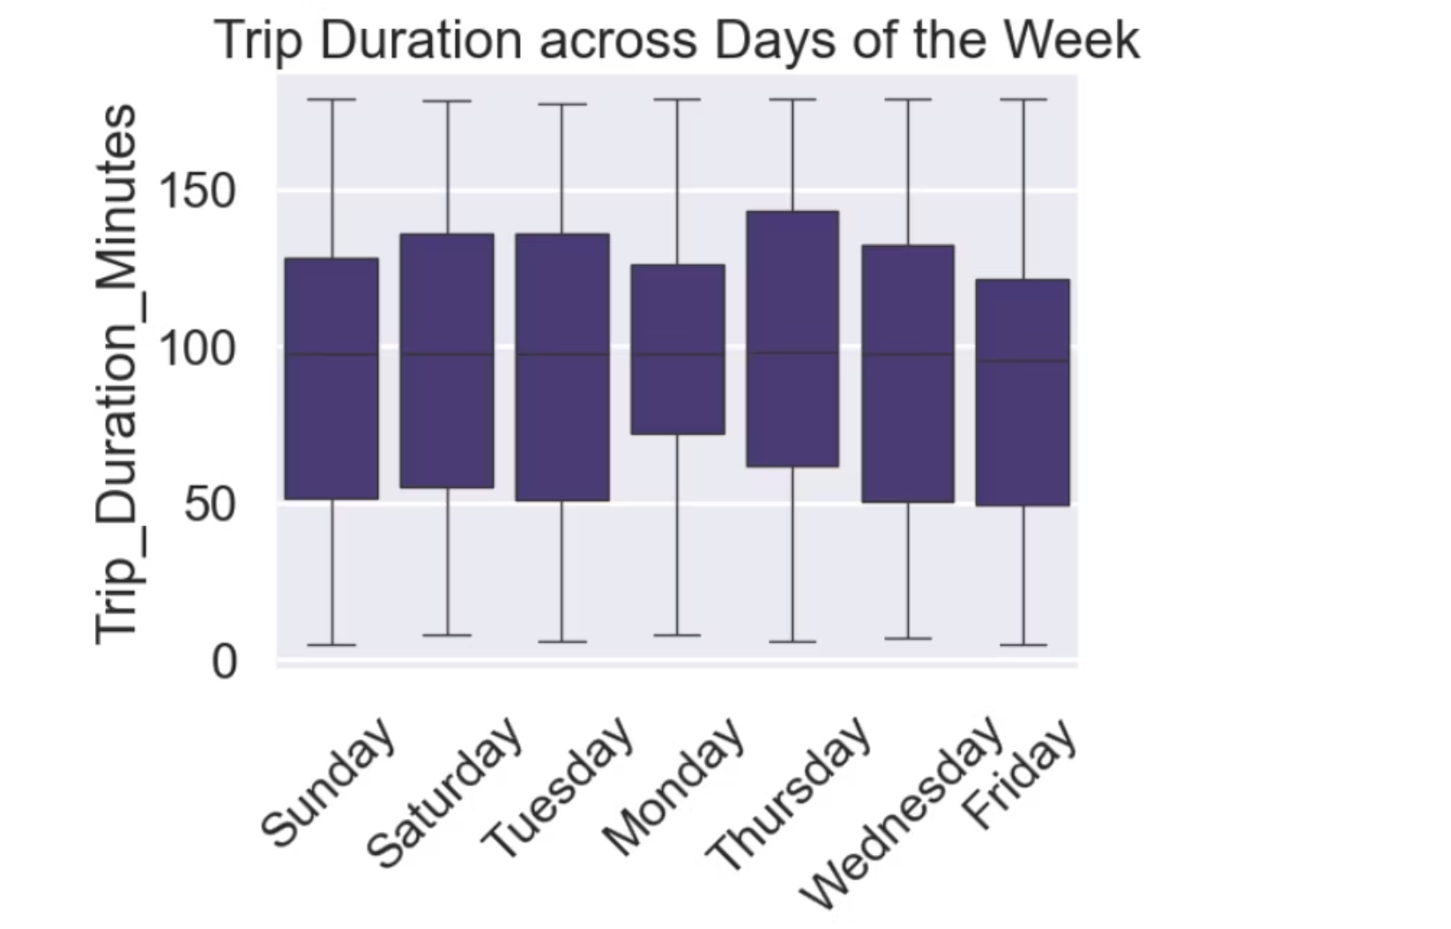
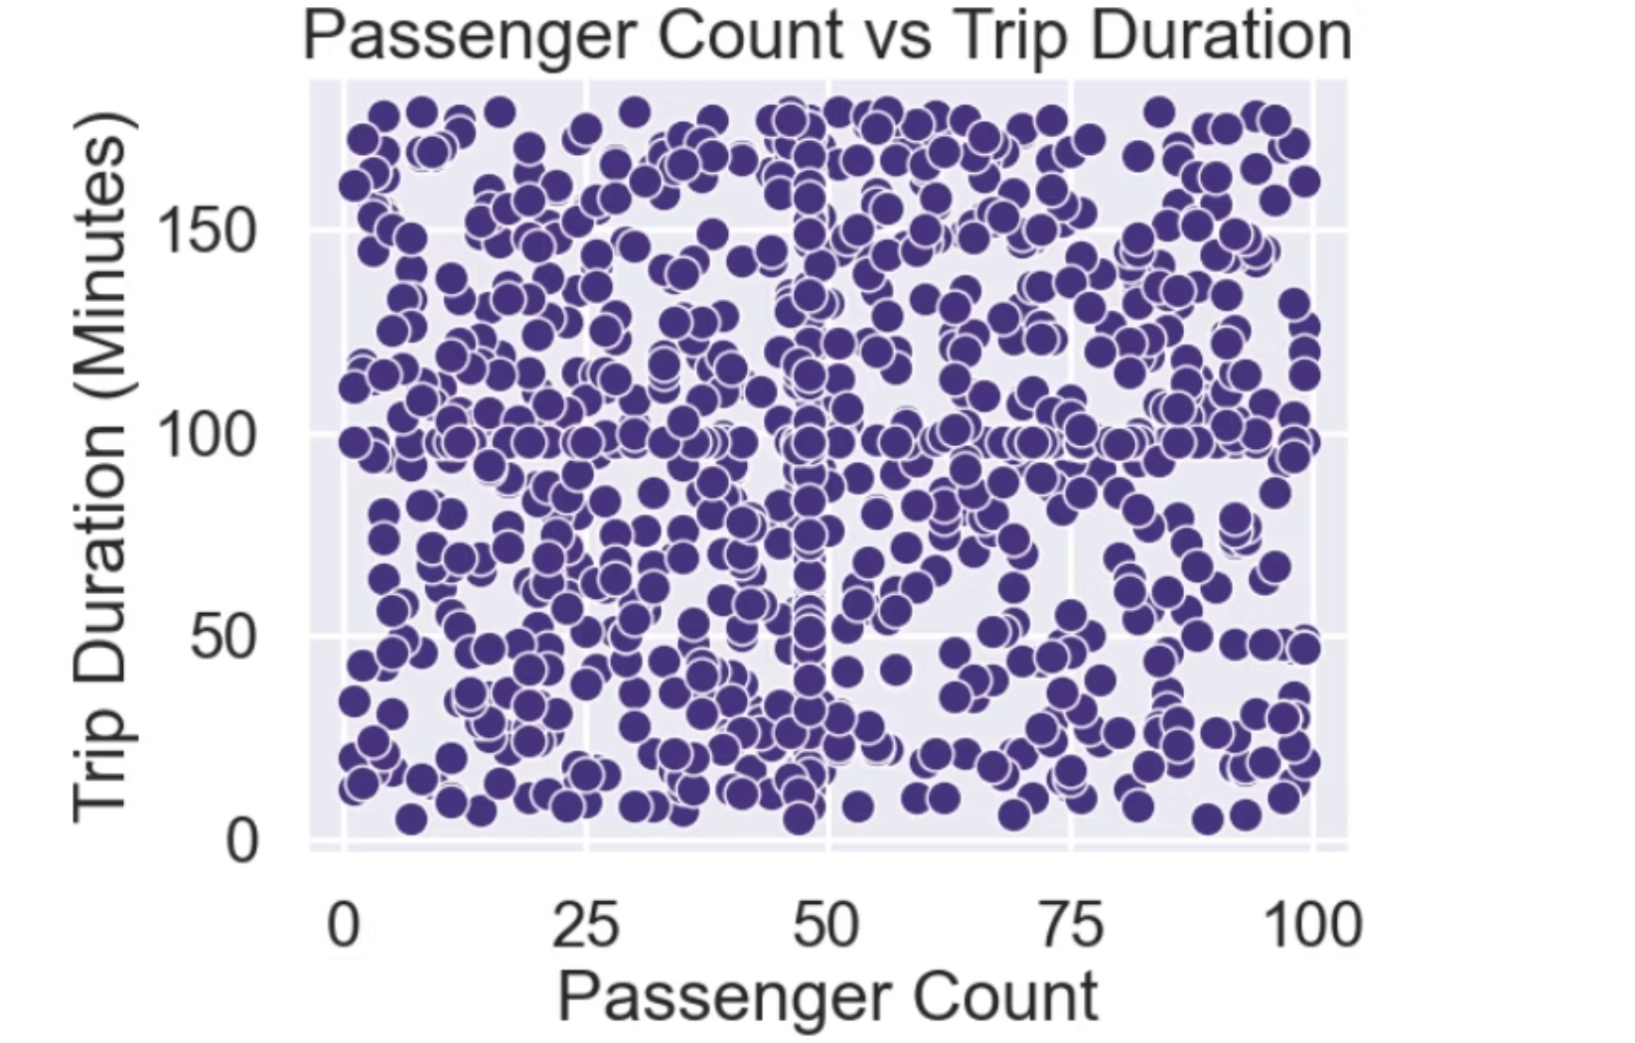
BIVARIATE ANALYSIS
Passenger Count vs Trip Duration
Heavier traffic or congestion on Thursdays, causing longer travel times. Longer-distance trips are more common on Thursdays maybe due to specific events or schedules.
This shows the summary of passenger count and trip duration

Slide 11
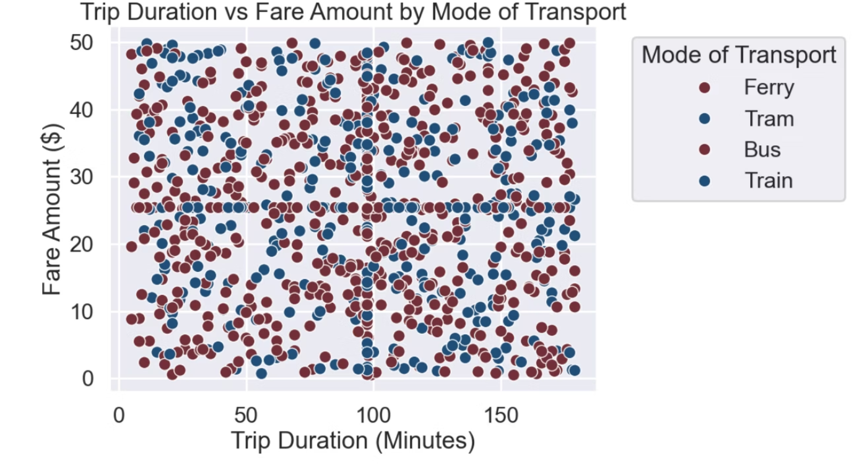
MULTIVARIATE/DATA SUMMARY
The summary of this is that Longer trips generally cost more (fare increases with longer duration).

Slide 12
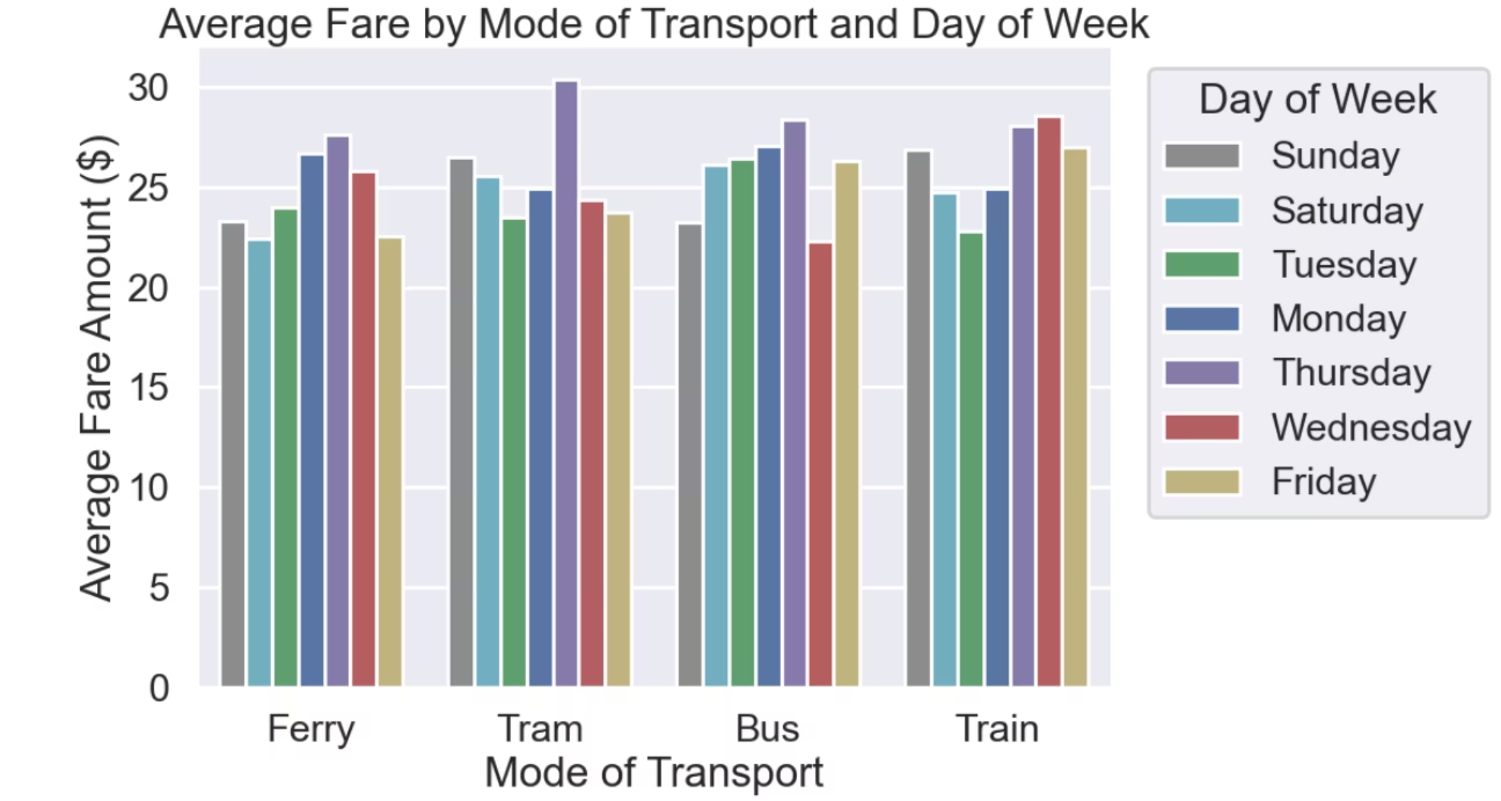
CONTINUATION
We can see that ferry has the highest amount of fares on Thursdays, As well as Tramp and bus , but train has the highest amount on Wednesday

Slide 13
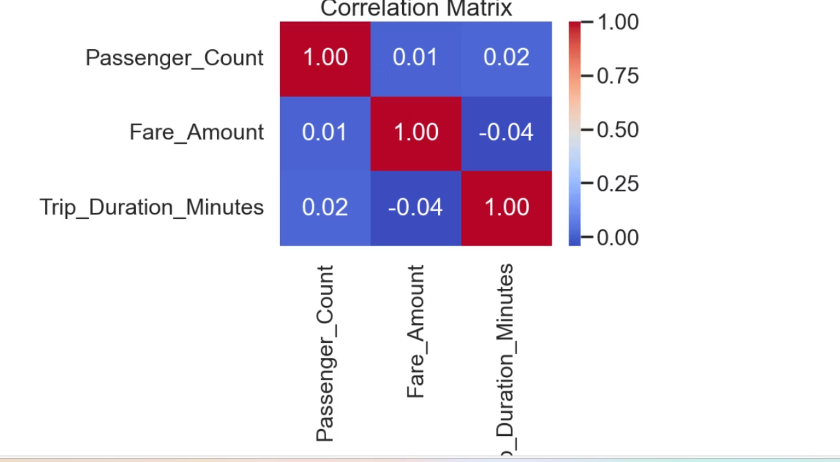
Passenger_Count vs Fare_Amount: 0.12 Very weak positive relationship ,More passengers might slightly increase fare, but not strongly.
Fare_Amount vs Trip_Duration_Minutes: 0.48 Moderate positive correlation ,Longer trips tend to cost more makes sense!
Passenger_Count vs Trip_Duration_Minutes: -0.05
Very weak negative relationship Essentially no meaningful pattern between how many passengers and how long a trip takes.

Slide 14

Due to the absence of key columns such as Scheduled_Arrival_Time and Actual_Arrival_Time, we were unable to evaluate trip punctuality or delay performance.
If the dataset had included:
Scheduled Arrival Time: The planned arrival time for each trip.
Actual Arrival Time: The recorded time when the trip ended.
then we would have been able to:
Calculate delays by comparing actual vs. scheduled arrival times.

Slide 15





Recommendations
Maintain and scale bus operations to match demand: Since we have alot of people that prefers busses
Improve awareness or coverage of underused modes (trams, ferries)
Boost service frequency on weekends, since people tend tom travel more on weekends
Reevaluate high train fares vs. service quality, then improve your other means of transportation on Thursdays due to traffic and other factors
Improve data tracking by including scheduled/actual arrival times

Slide 16
Conclusion
MetroMove can enhance operations by leveraging existing data
Data shows strong usage trends and areas needing improvement
Recommendations support smarter scheduling, pricing, and data collection

Slide 17

Thank You
Questions?

